Slide 1
SAP BTP Extension Suite Training
Day 23
Anubhav Oberoy
www.AnubhavTrainings.com
Follow excellence with sheer passion

Slide 2


DISCLAIMER
The training content and delivery of this presentation is confidential, and cannot be recorded, or copied and distributed to any third party, without the written consent of Anubhav Trainings

Slide 3
Agenda – Day 22
01
Scanner use case
02
Variables
03
Create SO App

Slide 4

Scenario – Supplier App
🧑‍💼 Persona: Jack Dowson – Procurement Manager
Age: 34
Location: Chicago, USA
Industry: Manufacturing
Role: Manages procurement for factory suppliers
Goals:
  Quickly find suppliers
  Ensure availability to take orders based on size
  On-board new suppliers with approvals
🎯 Objective
Design a user-friendly mobile app that allows Alex to:
Browse available suppliers
View detailed information
Add New suppliers
Edit Suppliers data

Slide 5
SAP BTP Build Process Automation
SAP Build Process Automation is a citizen developer solution to adapt, improve, and innovate business processes with no-code workflow management and robotic process automation capabilities.
SAP Build Process Automation enables business users and technologists to become citizen developers. With powerful yet intuitive low-code and no-code capabilities, the solution supports you in driving automation by tapping into the expertise of citizen developers.
Features
Build or adapt processes with an intuitive graphical interface.
Create forms-based workflows using drag-and-drop functionality.
Develop and manage decision logic in tabular, spreadsheet-like decision tables.
Automate repetitive tasks within existing process flows using robotic process automation.
Create intelligent actions and recommendations using machine learning capabilities.
Work efficiently from a unified launchpad and task center.
Hand over projects to professional developers, who can embed actions and advanced workflows into projects initiated by citizen developers.
Support real-time, event-driven transparency into comprehensive processes and process instances with process visibility dashboards.
In addition, SAP Build Process Automation offers prebuilt content and features – such as bots, process steps, business rules, and workflow components.

Slide 6
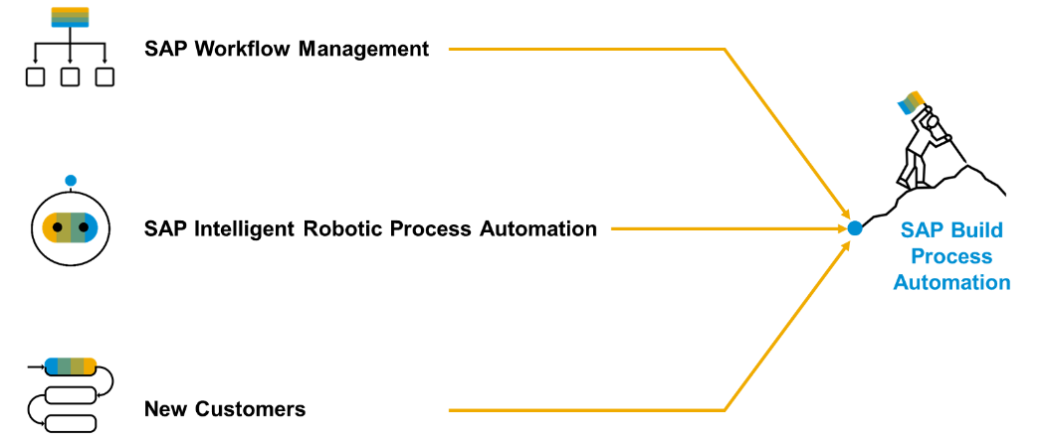
Product Overview
SAP Build Process Automation is a solution that evolved out of the former stand-alone SAP products - SAP Workflow Management and SAP Intelligent Robotic Process Automation. It provides a new citizen developer experience that didn't exist in either of the two former products.
As you or your company might have used SAP Workflow Management or SAP Intelligent Robotic Process Automation in the past, you are looking for a path into the joined solution. Fortunately, SAP Build Process Automation is fully compatible with all workflow and automation artifacts that you have created.

Slide 7

Hands-on Create process for Alex

Slide 8
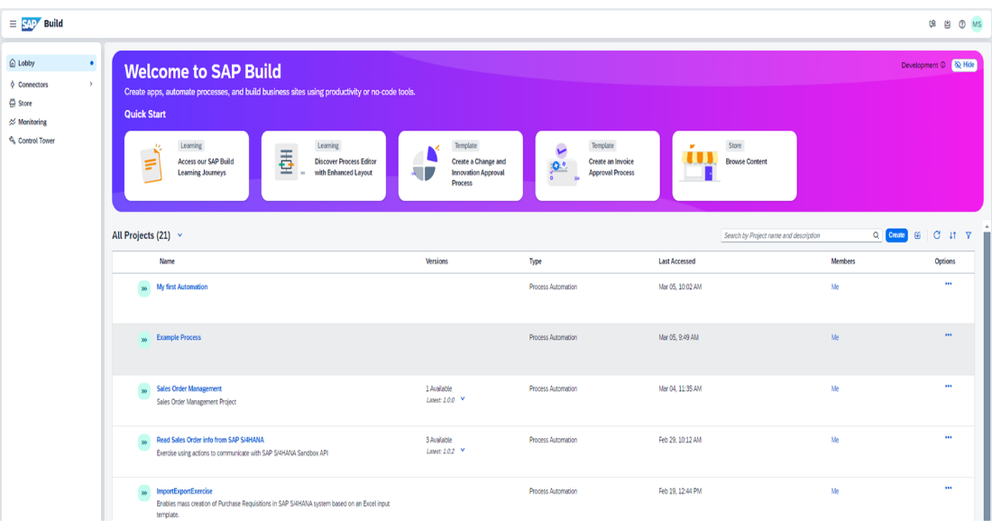
Core Components
Lobby – Centrally view and manage all build apps and business processes.
Process Builder- a LCNC design studio to design the business process and add multiple tasks
Connectors – configure connections with the systems
Store – Explore and import pre-built SAP standard process content
Monitoring – Analyze and monitor the on-going processes
Control Tower – Discover the implementation guide and configure IRPA desktop agents

Slide 9

What We Did
Let’s Summarize

Slide 10

www.anubhavtrainings.com
Thank You
End of Day 20

Slide 11


We’re committed to empower you to be
#FutureReady
through powerful training solutions.
We build the workforce of the future.
260+
Corporate Clients
60,000+
Learners Trained
26000+
Learners Placed
FREE WEBINARS
Sign up for free webinars with industry experts every fortnight!
Enroll Now!
Contact us today!
https://anubhavtrainings.com

